Slide 1
Welcome to the world of Cambrian Multimedia presentation.

Slide 2
Introduction
Md Hasan Hafizur Rahman
Senior Lecturer
Department of English
Cambrian School & College,Dhaka,
Class-Nine
English
1st Paper

Slide 3
My dear students, do you have any idea about a dialogue?
Let us follow below.

Slide 4
Our Today’s Lesson is-
A dialogue on
“Bad Effect of Smoking”

Slide 5
Learning outcomes
After we have studied this lesson we will be able to-
tell the cause smoking
the effect of smoking
ask and answer questions
write a dialogue.

Slide 6
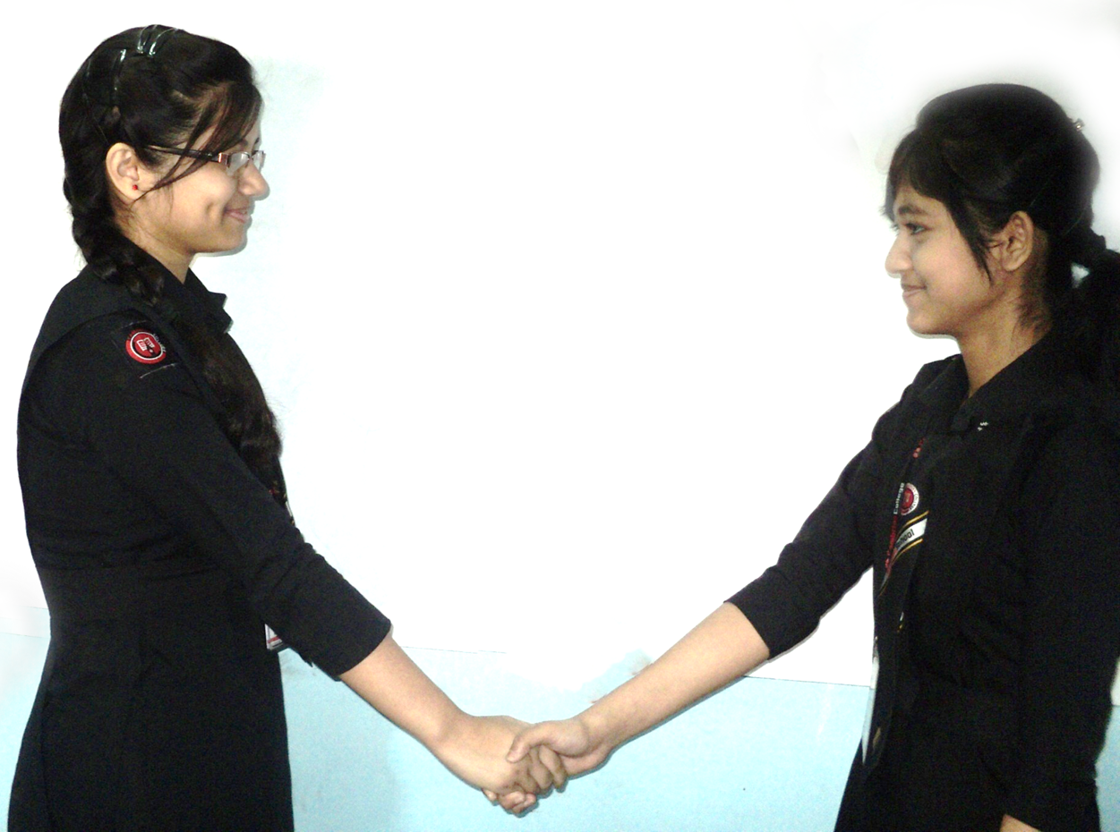
Hi friend, How are you?
I am fine and you?

Slide 7
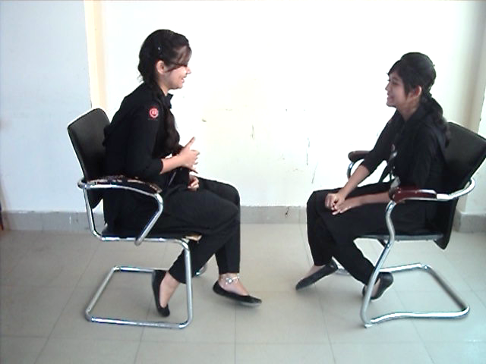
I am not so fine.
But why?

Slide 8
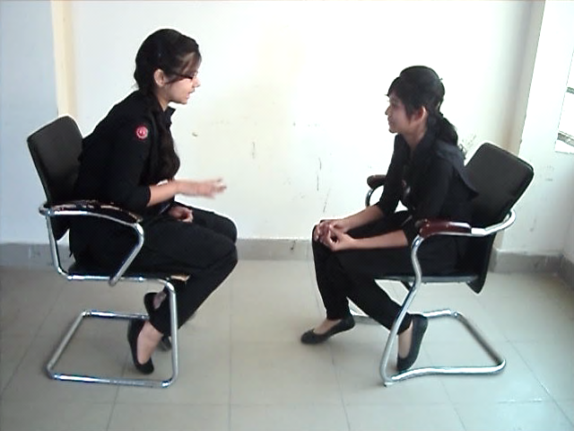
My uncle is very sick.
What kind of sickness?

Slide 9
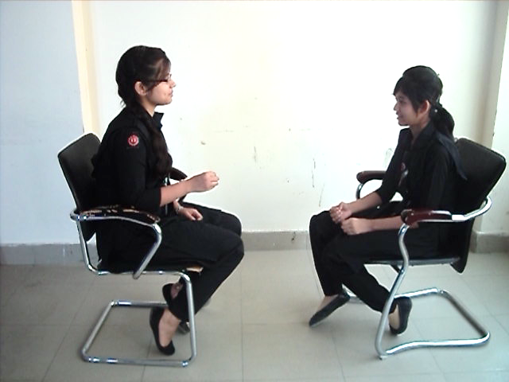
He has been suffering from cancer
What type of cancer?

Slide 10
It is liver cancer.
How is he attacked with liver cancer?

Slide 11
He is a chain smoker.
How long has he been smoking?

Slide 12
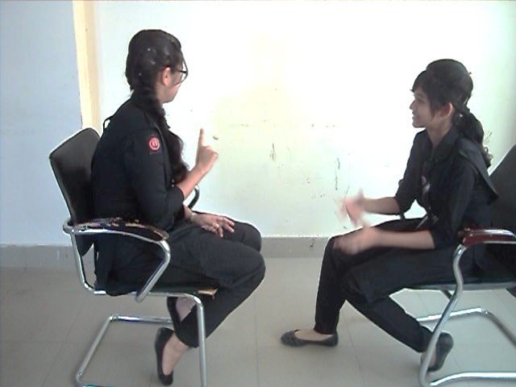
It is about 30 years.
30 years! It is really a long time. But how is it related to cancer?

Slide 13
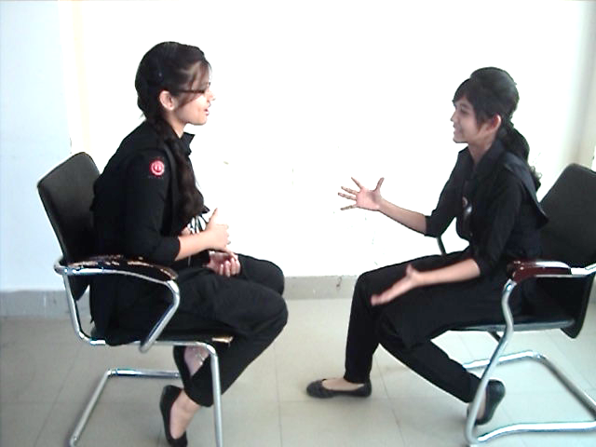
Smoking is the source of all kinds of fatal diseases like bronchitis, heart attack, cough, cancer and so on.
Smoking is really very injurious for health.

Slide 14
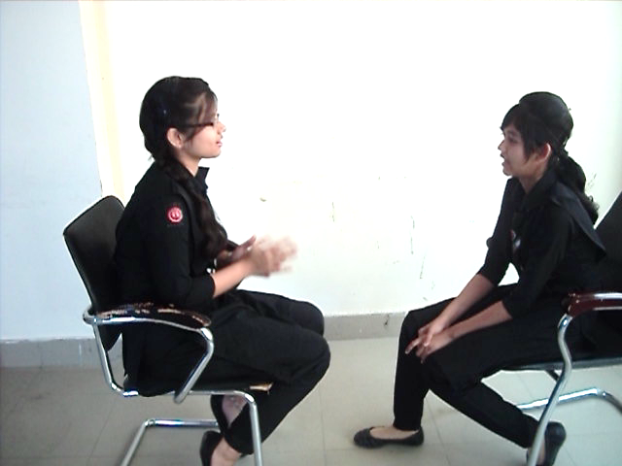
Why is smoking injurious?
Smoke contains nicotine. It is one kind of harmful poison for human body.

Slide 15
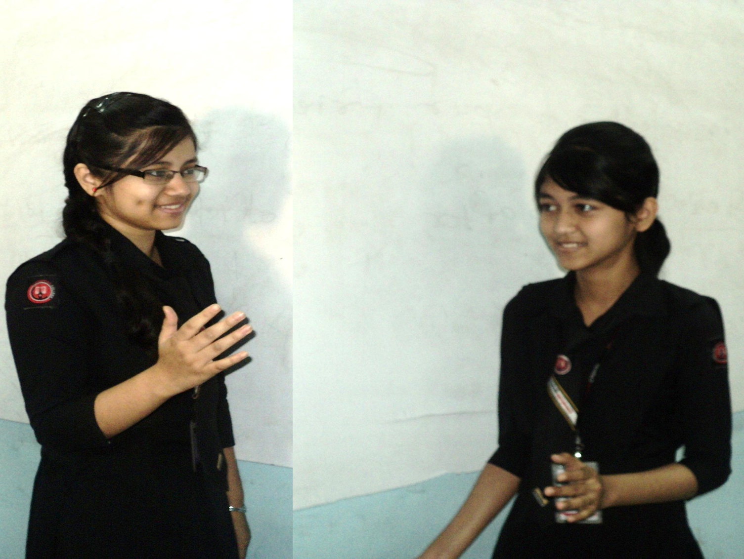
Why do people smoke?
People think that
it refreshes mind.

Slide 16
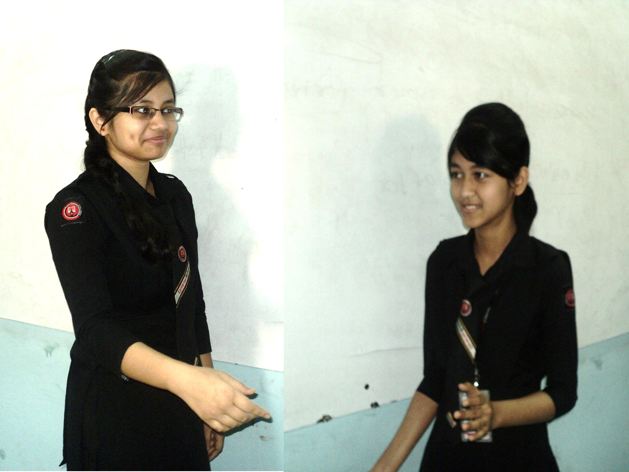
Is it actually refreshes mind?
No, It actually invites a man to addiction.

Slide 17
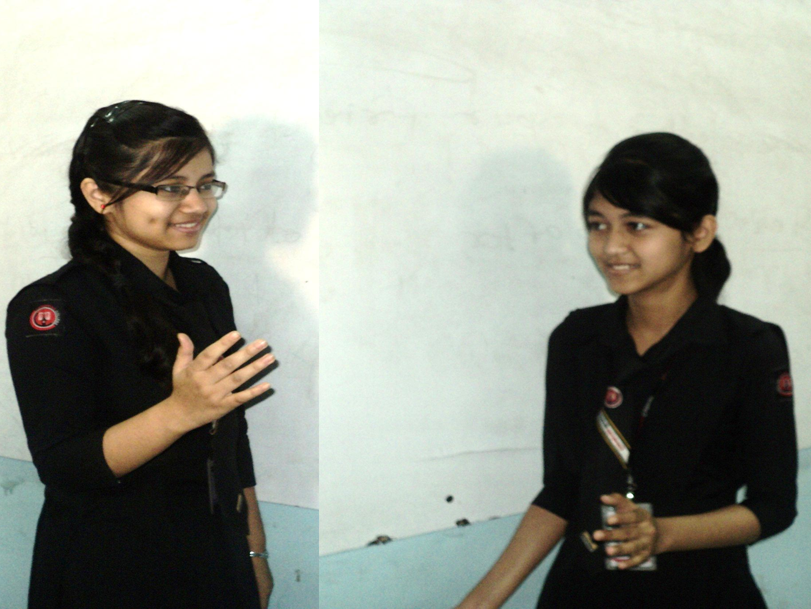
What is the bad effect of smoking?
There are many bad effects of smoking.

Slide 18
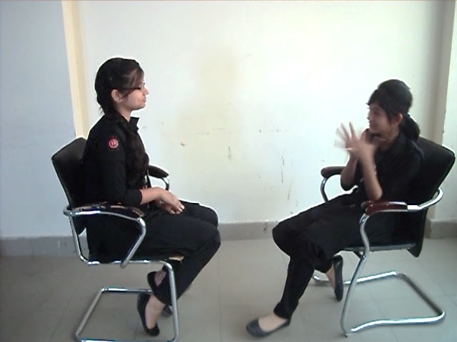
Would you please tell me some ?
Sure! Firstly, it costs a lot of money, gradually it leads a man to larger addiction.

Slide 19
What is the worst effect of smoking?
It ruins the golden future of a man specially a student who starts smoking.

Slide 20
Anything more?
Smoking makes a man impolite, sometimes it makes a man hijacker.

Slide 21
What should we do to get rid of smoking?
We should be aware of the bad effect of smoking to get rid of it.

Slide 22
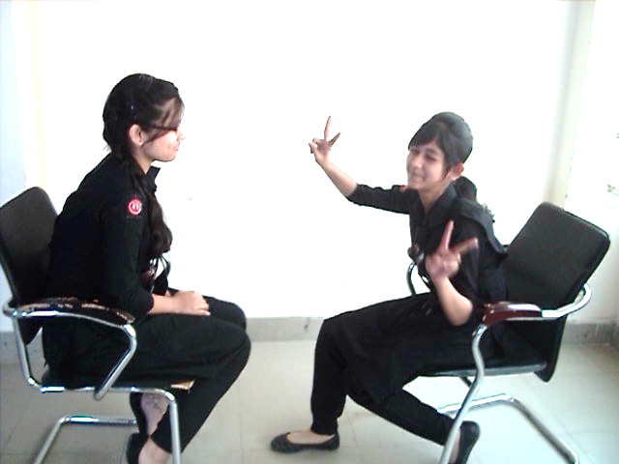
Thank you.
Welcome.

Slide 23
Pair Work
Every single pair is told
to write a dialogue on,
“ Bad effect of smoking.”

Slide 24
Evaluation
Answer the following questions-
What is smoking?
What kind of habit smoking is?
How does it harm to our body?
What is the bad effect of smoking?
What should we do to get rid of the problem?

Slide 25
Homework
Make an article on
“Bad Effect of Smoking”
in 150 words.

Slide 26
Advice
“Avoid smoking to lead a better life.”

Slide 27
Bye bye
Good bye

